Slide 1

Data is the new black
Data is the language of healthcare
Continuity of care
Administration
Patient safety
AI and decision support
Analytics, research, real-world evidence

Slide 2

FHIR + OMOP
are 2 of the 3 main interoperability standards in DH today*
Interoperability ⇒ scalability, adoption and
impact
*Tsafnat G, Dunscombe R, Gabriel D, Grieve G, Reich C Converge or Collide? Making Sense of a Plethora of Open Data Standards in Health Care J Med Internet Res 2024;26:e55779 doi: 10.2196/55779

Slide 3

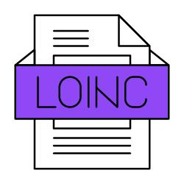


Terminologies
Standards like FHIR and OMOP can’t exist without standard terminologies

Slide 4
Terminologies
Standards like FHIR and OMOP can’t exist without standard terminologies
In other words:
Interoperable data are restricted to what terminologies can represent

Slide 5
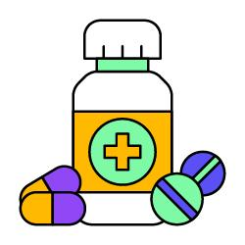

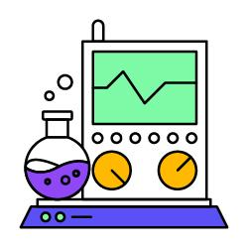

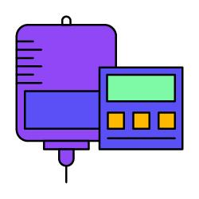

What terminologies represent well
drugs, diagnoses, labs, encounters, procedures… billable things

Slide 6
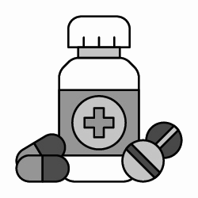

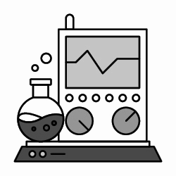
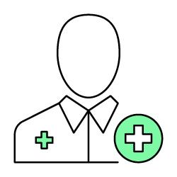







And what not so well…
drugs, diagnoses, labs, encounters, procedures… billable things
mental health, social determinants, social care, privacy & consent, family history, advanecd directives…

Slide 7
Vicious cycle
No terminology
No data
Vestibulum nec congue tempus
No evidence

Slide 8
Curiosity Camp #1
Largest, most diverse tribe
Ethicist
Clinician
Project managers
Software developers
Healthcare systems analysts
AI engineers
Advanced Directives

Slide 9


Curiosity Camp #1: outcomes
Terminology
3 classes of terminology
directive - what to do / not to do
cause - when to do / not to do
quality - conditions @ directive creation
>50 terms
FHIR terminology server
OMOP terminology repository
Advanced Directives

Slide 10
Curiosity Camp #1: outcomes
Monthly regular meetings
Most of the tribe continues to collaborate
International interest
Johns Hopkins
University of North Carolina Chapel Hill
Completeness
Sustainability
Advanced Directives

Slide 11

Curiosity Camp #1: lessons learned
Choices in the hands of the tribe
Mentoring and guidance
Diversity and inclusion
Project management only started at the camp
Ethics and values were evaluated after the fact

Slide 12


Curiosity Camp #2: the work continues
If it ain’t broke…
Another domain
Another tribe
mental health, social determinants, social care, privacy & consent, family history, advanecd directives…

Slide 13




Curiosity Camp #2: the work continues
If it ain’t broke…
Another domain
Another tribe
Or
It takes a village…
More diversity, brainpower…
More is more
mental health, social determinants, social care, privacy & consent, family history, advanecd directives…

